Slide 1

Mapping and Practical Skills

Slide 2

Map Scale
Map scale represents the relationship between distance on the map and the corresponding distance on the ground. The scale on the topo map is usually found at the bottom centre of the map. Scale is represented in different ways on a topographical map.
LINEAR OR DRAWN SCALE
RATIO Scale: 1:250 000
1
REPRESENTATIVE FRACTION Scale: 250 000
STATEMENT
One centimetre on the map represents one kilometre on the earth’s surface
NEVER SAY EQUALS!!
Not equals

Slide 3
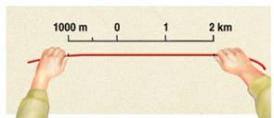
Calculating Distances
The distance between two points on a map can be found by measuring the distance on the map and then converting it from centimetres to kilometres and/or metres. Most students do this by using the map’s linear scale.
The distance between two points is measured in one of four ways:
Using a ruler
Using a straight edge
Using dividers
Using a piece of string or cotton

Slide 4
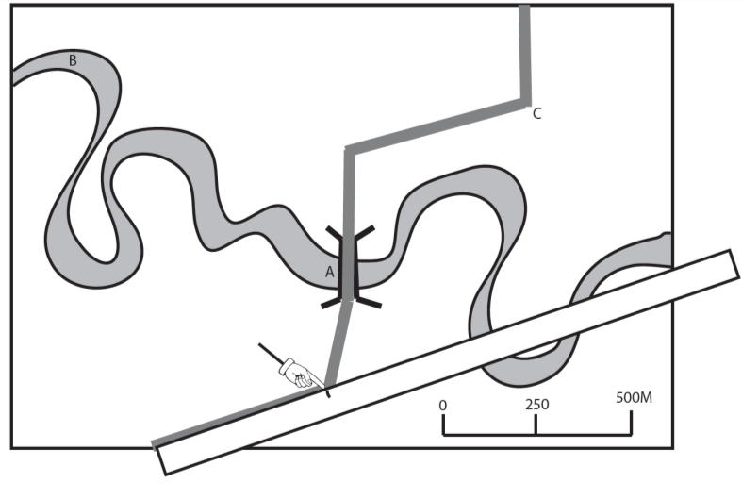
Calculating distances

Slide 5
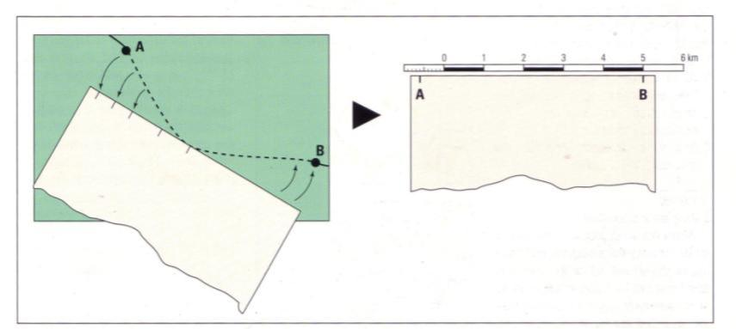
Measuring a distance along a curved line on a map

Slide 6
Map Scale
Medium-scale maps, e.g. 1:25,000, show a small area of land but provide a lot of detail of the features found in the area
Small-scale maps, e.g. 1:250,000, show a large area of land but provide less detail of the features found in the area

Slide 7
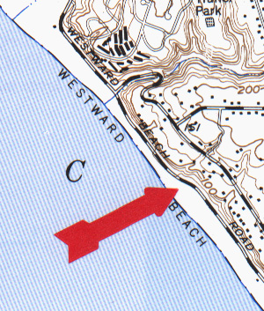
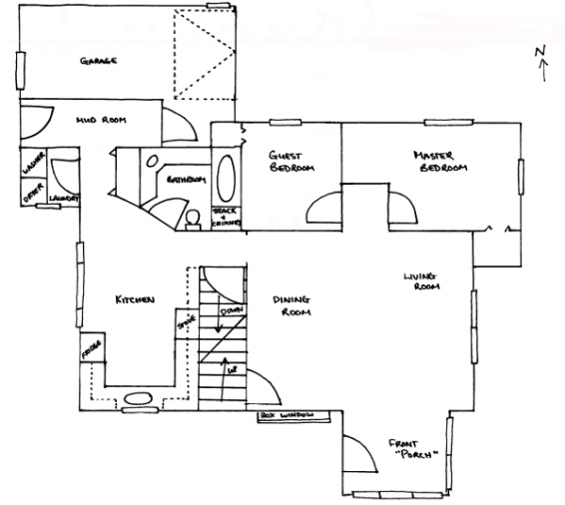
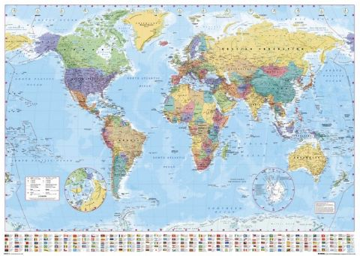
Types of ratio scales
Large Scales | Medium Scales | Small Scales
1:100 1: 10 000 1: 20 000 | 1:25 000 1: 50 000 1: 100 000 | 1:500 000 1: 5 000 000 1: 70 000 000
House plans Orienteering maps Road directory maps | Topographic maps | Regional touring road maps State and National maps Atlas and world maps

Slide 8
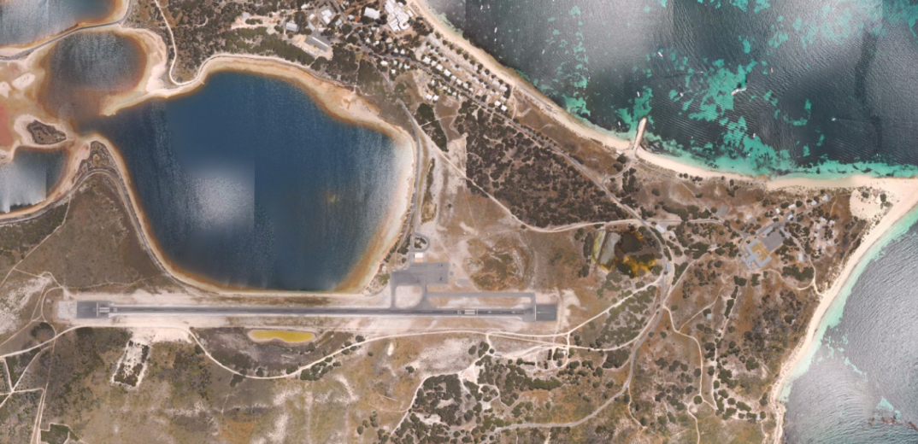
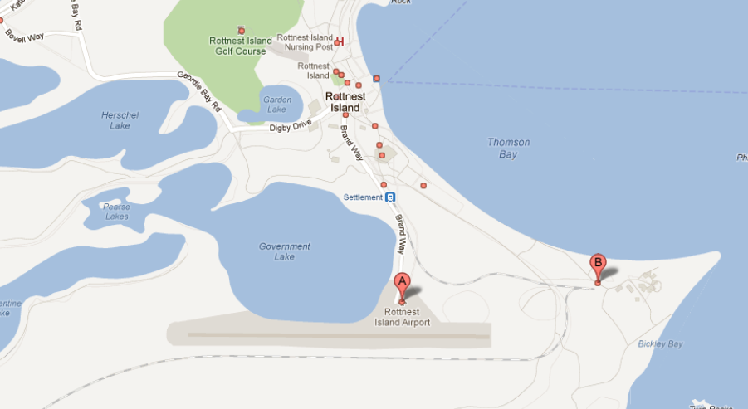
How to Calculate the Scale of an Aerial Photograph
Measure the distance between two distinct features
Hints
The two features must appear on both the map and aerial photograph.
Use human features eg. road junctions, buildings.
A greater distance between the two features will produce a more accurate answer. Aim to find two features at least about 10 cm apart.
Try and measure a distance on the photo that is a whole number

Slide 9
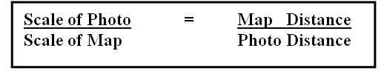
How to Calculate the Scale of an Aerial Photograph
Example: Map Scale is 1:50 000
Measure the direct distance between the same two points on the aerial photo eg. 10cm
Measure the direct distance between two points on the map eg. 6.5cm
Ratio of Scales = Ratio of Distances
Scale of Photo = 6.5cm
50 000 10 cm
Scale of Photo = 6.5 x 50 000
10
= 325 000
10
= 32 500
Scale of Photo = 1: 32 500
The aerial photo has a LARGER SCALE than the map.

Slide 10
Comparing Scales
Now it’s your turn…..
The distance between the 2 features is 10 cm on a map with a scale of 1:25,000. The distance between the same 2 features is 4cm on the aerial photograph.
Question: What is the scale of the aerial photograph?

Slide 11
Answer
Scale of Photo = 10 cm
25 000 4 cm
Scale of Photo = 10 x 25 000
4
= 25 0000
4
= 62 500
Scale of Photo = 1: 62 500
Note: The Map with the longer line distance between the places on the map has the larger scale

Slide 12
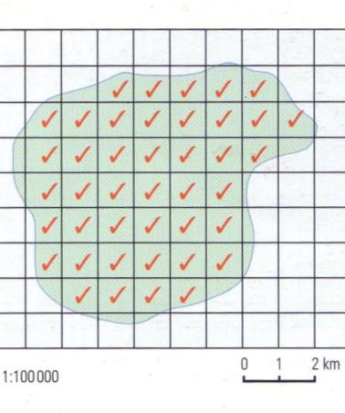
Estimating area
For features which are irregular in shape (e.g. lakes) count the number of complete grid squares that the feature occupies along with the number of incomplete grid squares to give the area in square kilometres
Example: determine the area of the island
There are 42 complete grid squares. Since each grid square is 1 square kilometre the approximate area of the island is 42 km
2

Slide 13
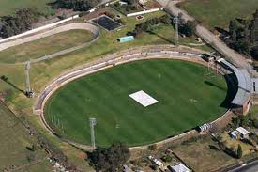
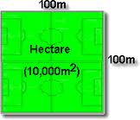
Area
Questions involving the calculation of area frequently expect you to deal in Hectares or Square Metres
E.g. A football oval is about:
2 hectares (200 m by 100 m) or 2000 m²
1 hectare is 100 m by 100 m (1000 m²)
1 sq km is 100 hectares

Slide 14
Calculating Time
When working with topographic maps you may be required to calculate how long it would take to travel a specific distance at a certain speed.
Example: how many minutes would it take to travel 30 km at 80 km/h?
distance
30 km
=
0.375 hrs
time =
speed
=
80 km/h
Note this answer is in hours
distance
distance
To convert 0.375 hours to minutes you need to multiply by 60 (because there are 60 minutes in an hour)
time
= 0.375 x 60
= 22 minutes
speed
time
speed

Slide 15

NOTE
Many students forget to convert their answer to minutes by multiplying their answer by 60!

Slide 16
Time Speed Distance Test
distance
Try these
d = 20 km s = 30 km/h t = ?
d = 35 km s = 105 km/h t = ?
d = 24 km s = 90 km/h t = ?
d = 80 km s = 15 km/h t = ?
speed
time
40min
15min
16min
20min

Slide 17
Relationship between transport and relief
Question Example: describe two influences of relief on transport routes Note that the term “relief” can be equated to topography and landforms
Model answer (obviously depends on the map):
Major roads avoid the steepest gradients by following valleys and moving up or down slopes at a slight angle rather than directly. Tracks take more direct routes across the slopes.
There are few transport routes in steep terrain.
Major roads do not traverse the highest points on the landscape.
There are few sections of straight road or tracks as they follow a winding course to access the more gentle slopes and avoid the highest points.

Slide 18
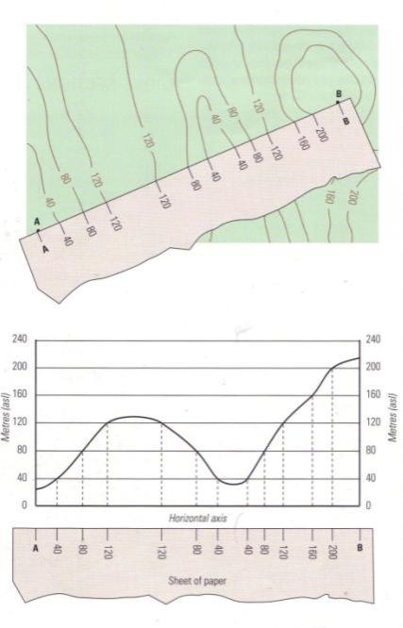
Cross section
Drawing a cross section from a topographic map is a very useful way of interpreting contour lines and gaining a visual impression of the shape of the land.
Drawing a cross section
Step 1: place the straight edge of a piece of paper along a line joining points A and B.
Step 2: starting from Point A, mark the position where the edge of your sheet of paper cuts each contour line. Write the value of each contour on your sheet of paper
Step 3: Draw the horizontal and vertical axis of your cross section. The length of the horizontal axis should equal the length of line A – B
Step 4: Place your sheet of paper along the horizontal axis and then plot the contour points and heights as if you were drawing a line graph
Step 5: Join the dots with a single smooth curved line.

Slide 19
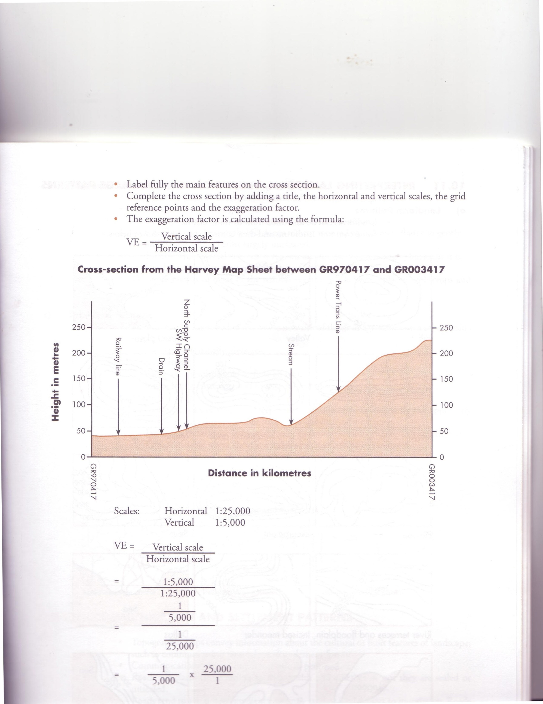
Important elements of a cross section
The following elements are important in a cross section:
Title
Horizontal and vertical scales
The grid reference points
The Vertical exaggeration
Annotation of features if required

Slide 20
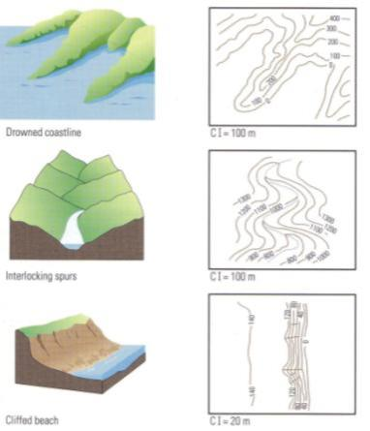
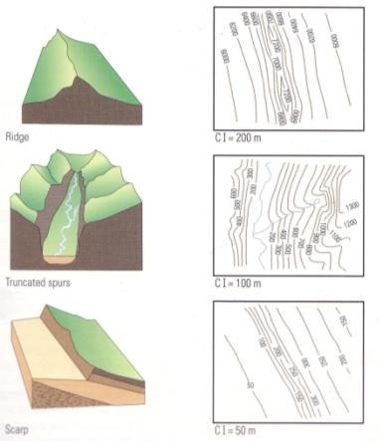
Interpreting Landforms
Landforms can be identified from contour shapes

Slide 21
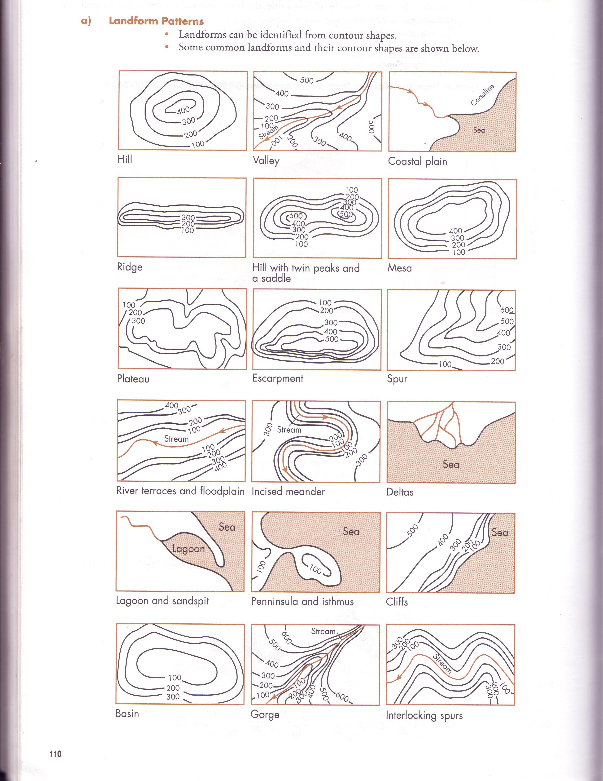

Slide 23
The ones you NEED TO KNOW
You should be able to recognise the basic topographical features from the contour patterns for the following:
Great news….you don’t have to know every one. Take out your syllabus!!!

Slide 24
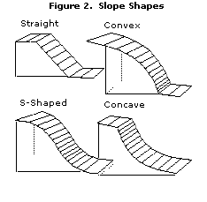
Shape of slope: Concave or Convex
The shape of a slope is a good sign of how stable it is. Straight and S-shaped slopes tend to be more stable than concave or convex slopes.

Slide 25
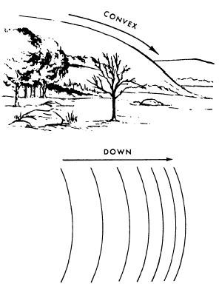
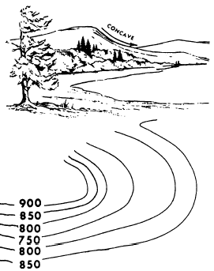
Concave or Convex
Convex slope Concave slope

Slide 26
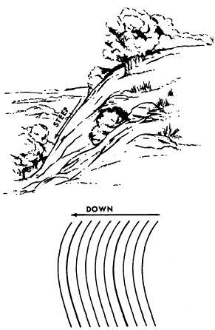
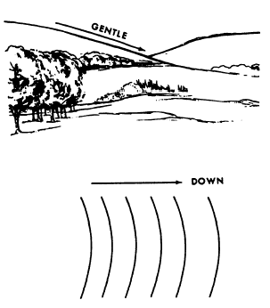
Uniformity
Uniform, gentle slope Uniform, steep slope

Slide 27
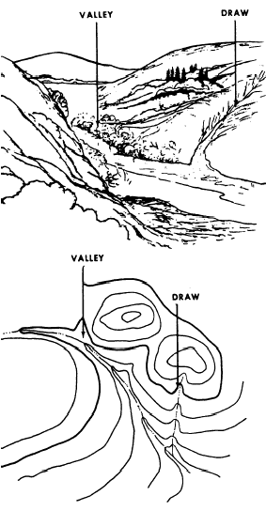
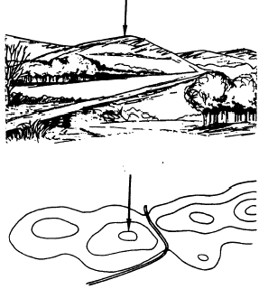
The Ups and Downs
Hill Valley

Slide 28
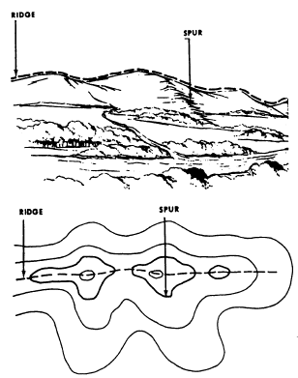
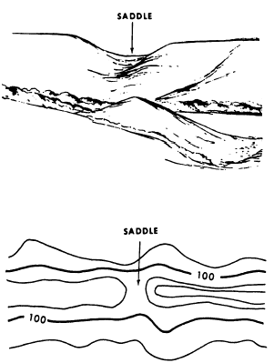
Other Features
Ridge and spur Saddle

Slide 29
NOTE
When asked to give map evidence, you must give GRID REFERENCES and refer to specific names on the map.

